Slide 1
Call for Code Spot Challenge: Australian Wildfires
Data Warriors
Notes:
Thank you for this opportunity for me to speak on our take for the wildfires challenge. My name is Albert and I’ll be speaking on behalf of Data Warriors.

Slide 2



Data Warriors: Introductions
Albert Um
Data Scientist
Bachelors in Finance
Manufacturing Consultant
Certified in Production and Inventory Management
Shruti Chaturvedi
Azure AI Engineer
DevOps Developer at Connexa.ai
Harvard WECode'21 Lead Tech Fellow
Bit Project ML Instructor
Divyansh Choubisa
Machine Learning Engineer
Bachelors in Computer Science Engineering
Notes:
The Data Warriors Team is comprised of myself, Shruti, and Divyansh. We came from different backgrounds and we met through the challenge slack channel.

Slide 3
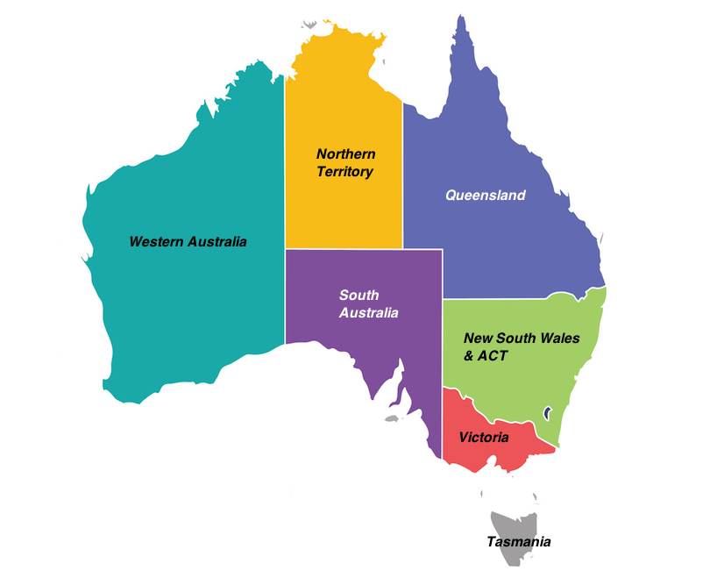
Competition Objective
Predict daily fire areas(in km2) by region for February 2021:
NSW - New South Wales
NT - Northern Territory
QL - Queensland
SA - South Australia
TA - Tasmania
VI - Victoria
WA - Western Australia
Leaderboard Evaluations:
80% MAE (Mean Absolute Error)
20% RMSE (Root Mean Squared Error)
Notes:
The Australian Wildfires Challenge started in November 2020 and has brought public attention to this natural disaster. The objective was to predict daily wildfires in km^2 by region for February 2021. Submissions are evaluated by 80% mean absolute error and 20% root mean squared error. The lower the error the better.

Slide 4
Process Outline
Data Study
Preprocessing
Model Evaluation
MCD14DL(wildfires)
ERAS data(weather)
MOD13Q1(vegetation)
Feature Engineering
Windowed Datasets
Dilated Convolution Neural Network
Notes:
I’ll break down the presentation into 3 steps.
Data study, a short explanation about the datasets provided.
Some features I came up with and preprocessing the dataset
An explanation of how Conv1D Layers are applied to sequences

Slide 5

Data Study
MCD14DL (Wildfires)
ERAS Data (Weather)
MOD13Q1 (Vegetation)
Notes:
The competition provided a stack of csvs. The datasets that I used were the historical wildfires, weather, and vegetation.
I think it’s important to try to interpret how these datasets were preprocessed.
The wildfires dataset comes from the MCD14DL which uses MODIS thermal anomalies raster images.
The “estimated fire areas” are computed by multiplying the track and scan values from the MCD14DL.
The track and scan values are calculated due to the difference in pixel resolution from the original image.
To put it in short, the original MODIS image has a 1km pixel resolution but the pixels further away from the satellite are actually larger than 1km.
The areas are then aggregated by region for each day. Doing this has compressed petabytes of data to a workable csv.
The weather and vegetation data has also been compressed by region and aggregated by mean, standard deviation, min and max.
The gif below represents the daily NDVI values for Australia in 2020. I included this gif to represent how huge the original datasets actually are before compression.

Slide 6
Preprocessing Features
Log Scale
Surface Area
Weather & Vegetation Means
Precipitation, Relative Humidity, Soil Water Content, Solar Radiation, Temperature, Wind Speed, NDVI
Wildfires have a power law-like distribution. Log transform the estimated fire areas.
Feature engineer the expansion variable for wildfire areas.
Notes:
For modelling, I utilized the weather and vegetation means, log scaled wildfires, and surface area for my features.
Weather and vegetation stats were aggregated by mean per region and some include precipitation, relative humidity, soil water content and ndvi.
Wiildfires, like most disasters, have a power law like distribution. In general, there are no disasters but when there is, it can get huge. I log transformed the areas in order to have a more normal looking distribution and I’ll exponentiate after I predict.
The wildfires at time t has a strong correlation with the wildfire area at time t + 1.
I think this relation is a bit indirect and the fire expansion is correlated with the surface coverage more than the actual area.
Like watching a yule log in christmas morning, the expansion of fire is correlated by the surface of the existing fire more than the area.

Slide 7
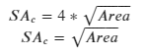
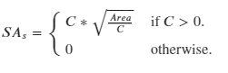
Feature Engineering: Surface Area
Conglomerated
Separated
Let :
SA = Surface Area
C = Count
Assume the fire area pixels are united to one large block per region.
Assume the fire area pixels are dilated and each pixel has equal area.
Notes:
It might be impossible to find the surface area because the wildfires were aggregated by sum.
However, I can make a few assumptions about the area and create 2 features.
The first is to assume the fire is conglomerated into one giant fireball. If the area is a square, the surface would be 4 times the square root of the area.
Since 4 is a constant, I drop it and just leave the square root of area.
The second is to assume the total area is made up of separating equal sized pixels, no pixel touching another pixel. The surface area can then be calculated as such. If there are no fires then the surface area would be 0.
Maybe some combination of these 2 features can generalize the actual surface area.

Slide 8
Model Evaluation
Predict up to February 28, 2021.
Training set
Testing set
Dataset ends on January 18, 2021.
The output steps will be 41 days (41 days + Jan. 18 = Feb 28)
January 01, 2005 - November 30, 2020
December 01, 2020 - January 11, 2021
Notes:
I’ll need to predict up to February 28, 2021 and the last day for the weather statistics that I had was January 18. Therefore, I needed to output a minimum 41 days in order to get all of February.
For evaluation, I withheld December 01 to January 18 from my training set.
And used mean absolute error as my metric because MAE makes up the majority of the total leaderboard score.

Slide 9
Convolutional Neural Network
Source: https://stanford.edu/~shervine/teaching/cs-230/cheatsheet-convolutional-neural-networks
Notes:
I utilized a DCNN(dilated convolution neural network) very similar to the WaveNet model that predicts soundwave sequences.
Traditionally, Convolutional neural networks are preferred for image classification. CNN provides an alternative way to analyze pixels. For example, a 500 by 500 image would have 250,000 pixels or input features if fed into a vanilla neural net. In CNN models, the images are applied a filter (usually 3 by 3 or 5 by 5) to reduce the number of inputs. As shown in the gif.
For time series, I used Conv1D layers and I’ll needed to window my training set into sequences.

Slide 10
Windowing Dataset
: Original Dataset(Daily) of Features
: Input steps (X) of Features
: Output steps (y) of Dependent Variables
: Number of Sequences
Original Shape:
(Observations, Features)
X Shape:
(Sequences, Input Steps, Features)
Y Shape:
(Sequences, Output Steps, Dependents)
t
Notes:
The idea is to slice the training set into sequences where the indices of the input and output incrementally increase by 1.
A sort of sliding window fashion, capturing the input and output steps as the window slides by 1.
The original dataset which is made up of days and features returns two tensors X and y.

Slide 11
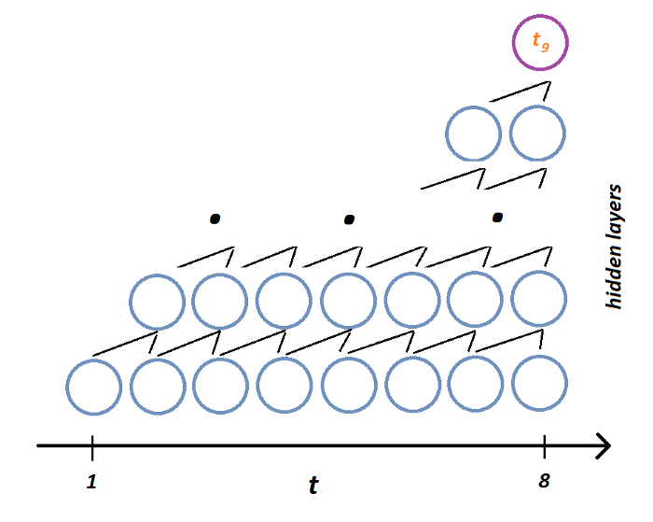
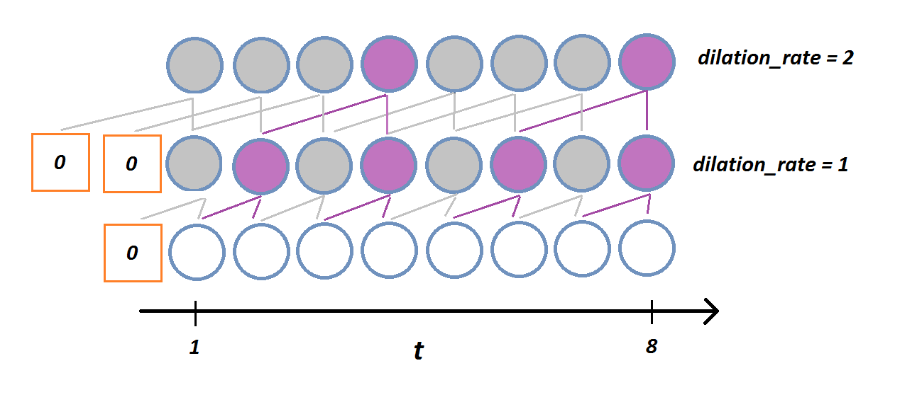
Conv1D Layers
Input Steps: 120, Output Steps: 41
Without Padding/Dilation
With Padding and Dilation
Notes:
I windowed my dataset with an input step of 120 days and output of 41.
A convoluted 1D layer is applicable to time-series and is generally faster than traditional LSTM or GRU layers.
The nodes of the conv1d layer are calculated using neighboring inputs that get shifted incrementally.
The addition of padding prevents the layers from losing its original shape and adding dilation reduces the number of hidden layers required.
Within the hidden layers, inputs are skipped at a dilation rate and an increasing dilation rate per layer can exponentially reduce the total number of layers.
I don’t believe the grey nodes are calculated during fit but I included it to show a representation of the model architecture.
The orange boxes with 0 is the padding type in order to retain the original shape.

Slide 12
Current Standings
February 01, 2021 - February 28, 2021
Mean Absolute Error: 7.03
Root Mean Squared Error: 19.60
Notes:
Test Set: December 01 - January 11: MAE: 21.07 and RMSE 66.47
Our predictions for February 2021 had a mean absolute error of 7.03 and a RMSE of 19.60.

Slide 13
Further Steps
AutoRegressive
Google Earth Engine
Incorporate autoregressive mode into model.
Reaggregate data to administrative level 2 or custom hexagon shape.
Notes:
For my next steps, I plan to incorporate an autoregressive element into the model.
I’ll also like to reaggregate the datasets.
wildfires, weather, and vegetation data to the county level.. This would provide a more granulated dataset while still compressing enormous raster images..

Slide 14
Thank you!
https://github.com/albertum1/cfc_team
Notes:
Thank you for making it to the end!

